Slide 1






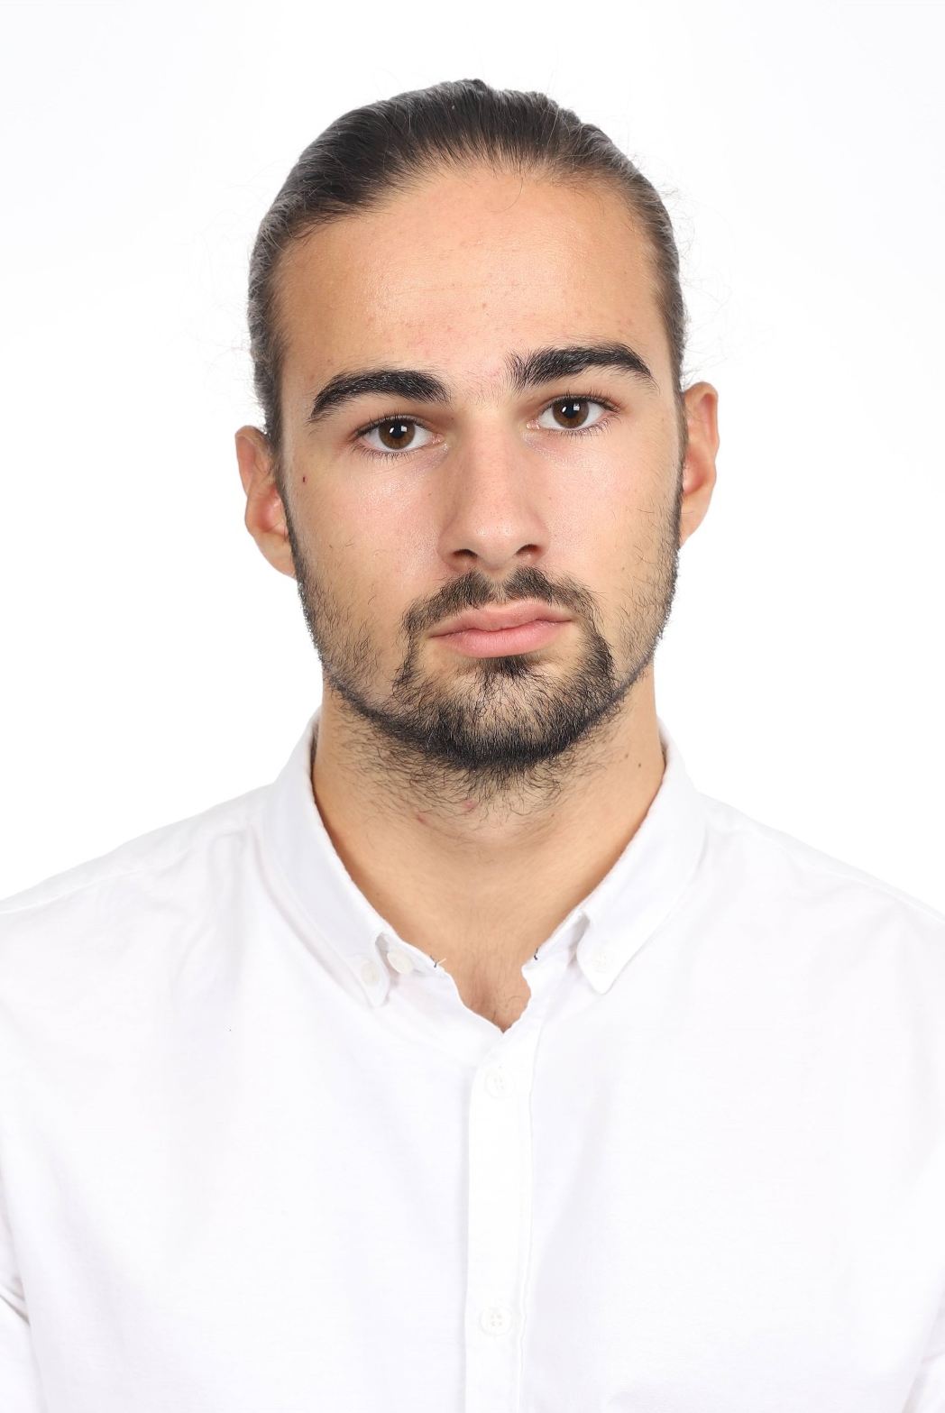
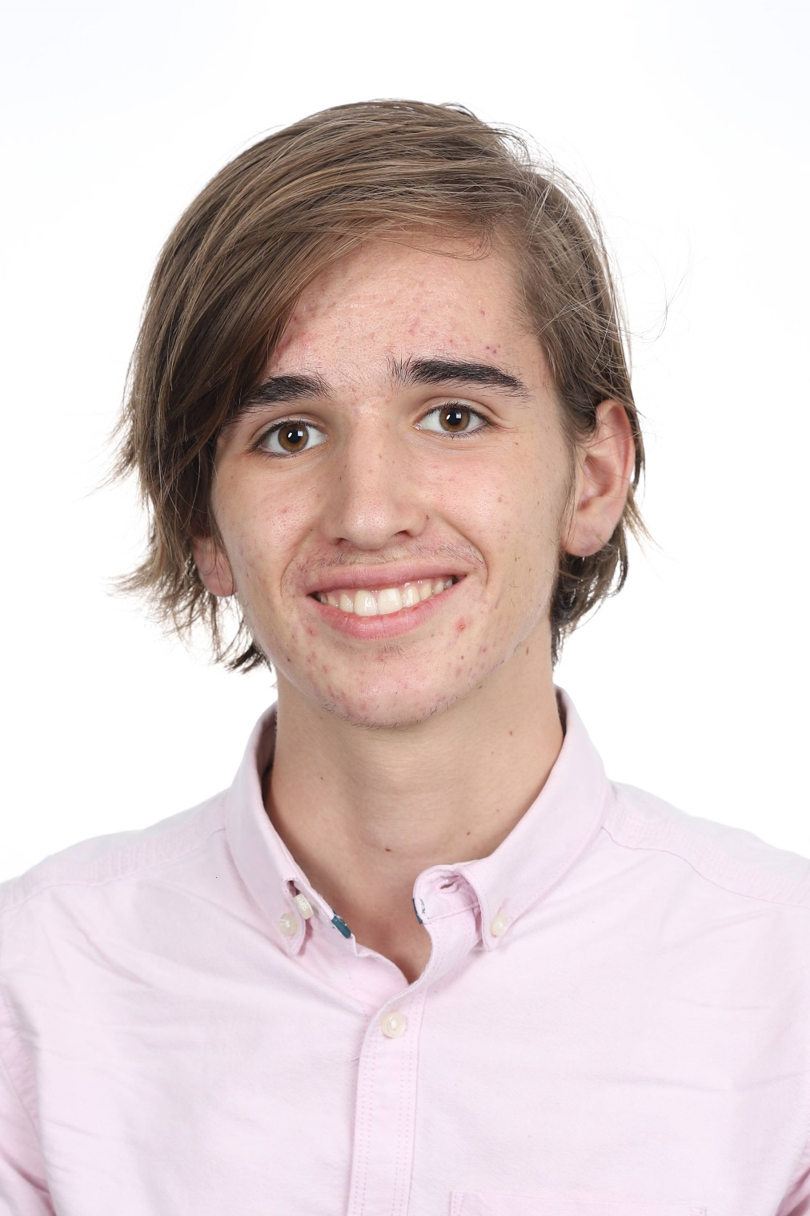
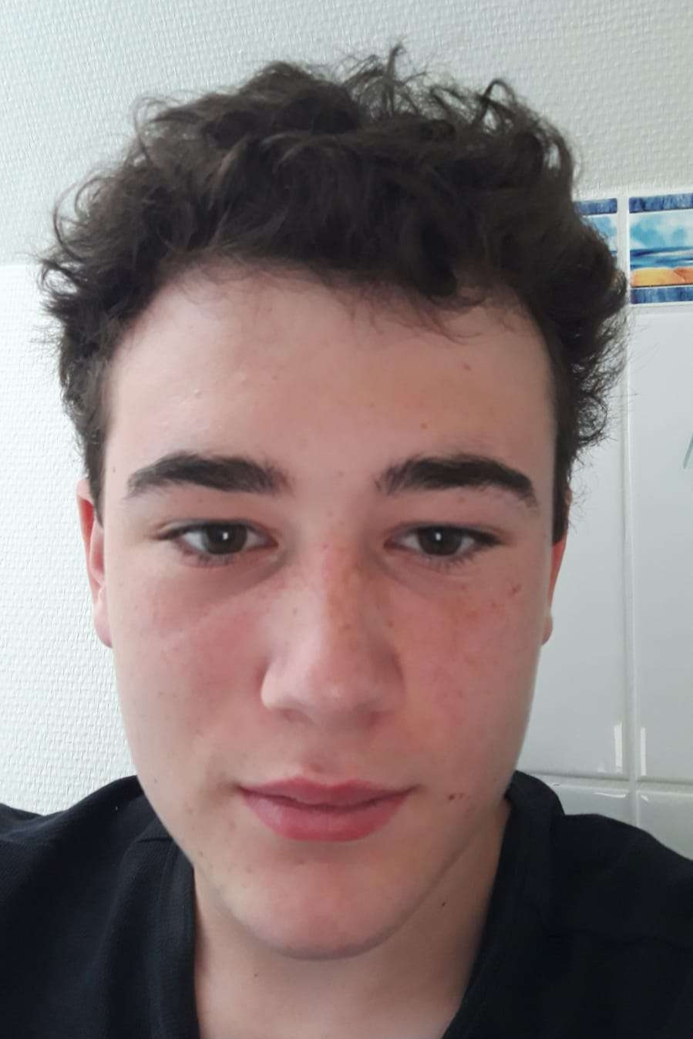
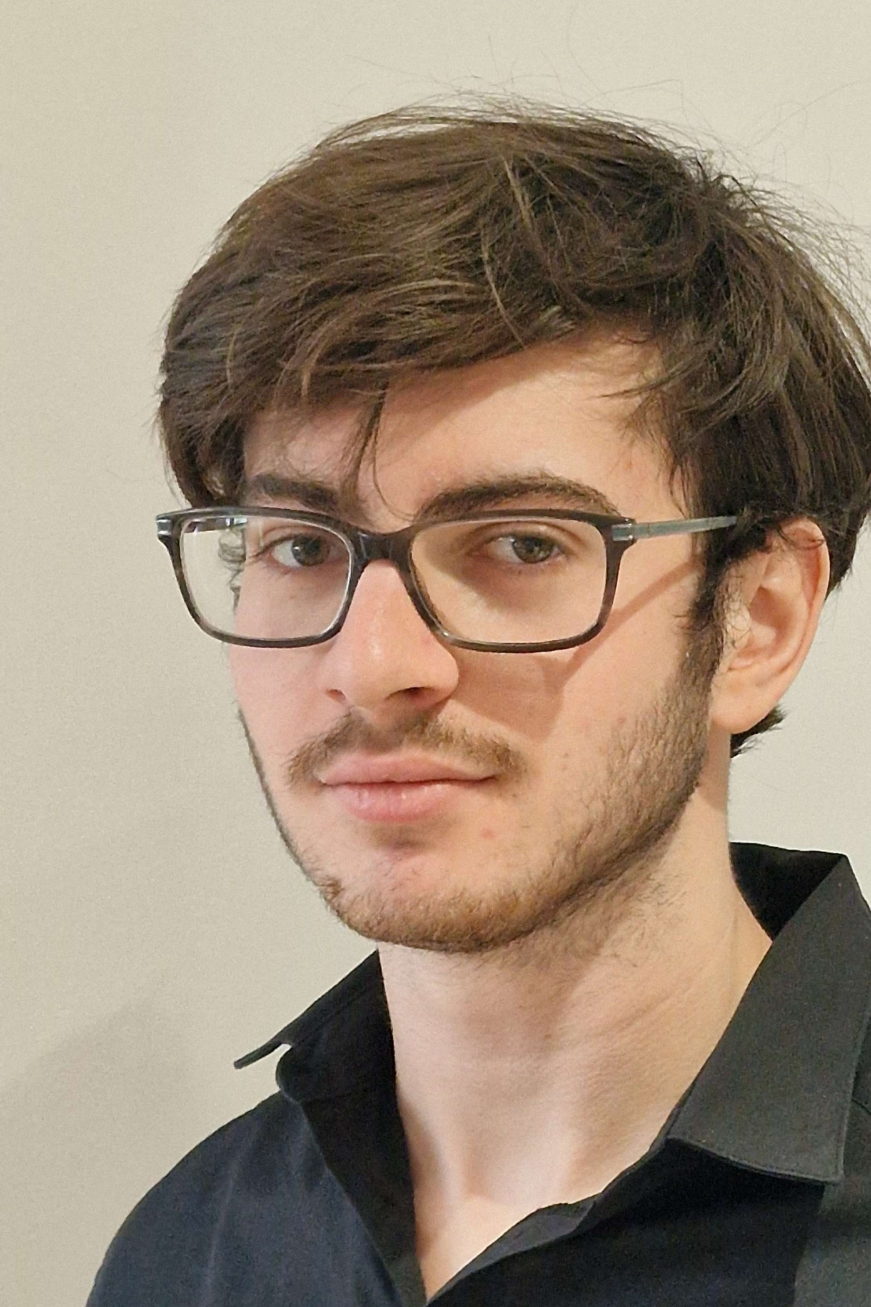
²
Senzo No Michi
ZenTianJi Corp
Mathis Galliano
- Group Chief
- 3D Designer
- AI manager
Louis
Rodet
- Web Designer
- 2D Designer
- Scene manager
Abel
Chartier
- Gameplay developer
- Sound Designer
Antoine Mosimann
- Multiplayer Developer
- Git maintainer
senzo-no-michi.github.io

